Slide 1


Mantid
Manipulation and Analysis Toolkit for Instrument data

Slide 2
Agenda
Time | Item
9:00 | Introduction
9:05 | Python Overview and Running Algorithms
9:15 | Exercise 1: Removing the Prompt pulse
9:40 | Generating and generalising scripts
9:50 | Exercise 2: Create a reusable script
10:15 | Manipulating graphs and matrices
10:25 | Exercise 3: Controlling MantidPlot
10:50 | Mantid on the Command line
-- | Exercise 4: Mask detectors by detector efficiency
11:00 | Finish

Slide 3
Project Aims
Key features
  A framework for Data Analysis that is not instrument or technique/dependent.
  Supports multiple target platforms
    Windows, Linux, Mac OSX.
  Easily extensible by Instruments Scientists/Users.
    Python scripts
    New plugin algorithms
      Python or C++
  Freely redistributable
    Open Source
    GPL license

Slide 4
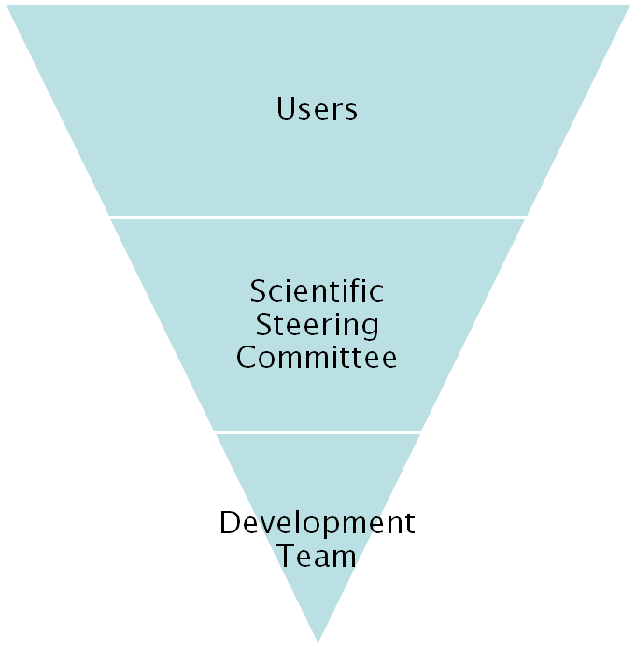
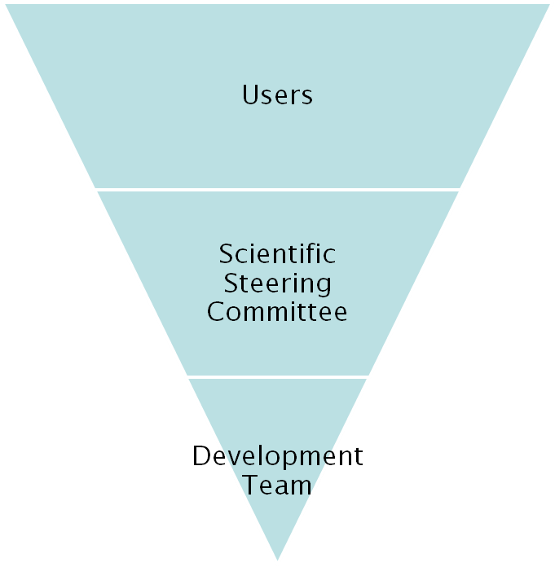
Project Organisation
ISIS
SNS/HIFR
Project Management Board

Slide 5
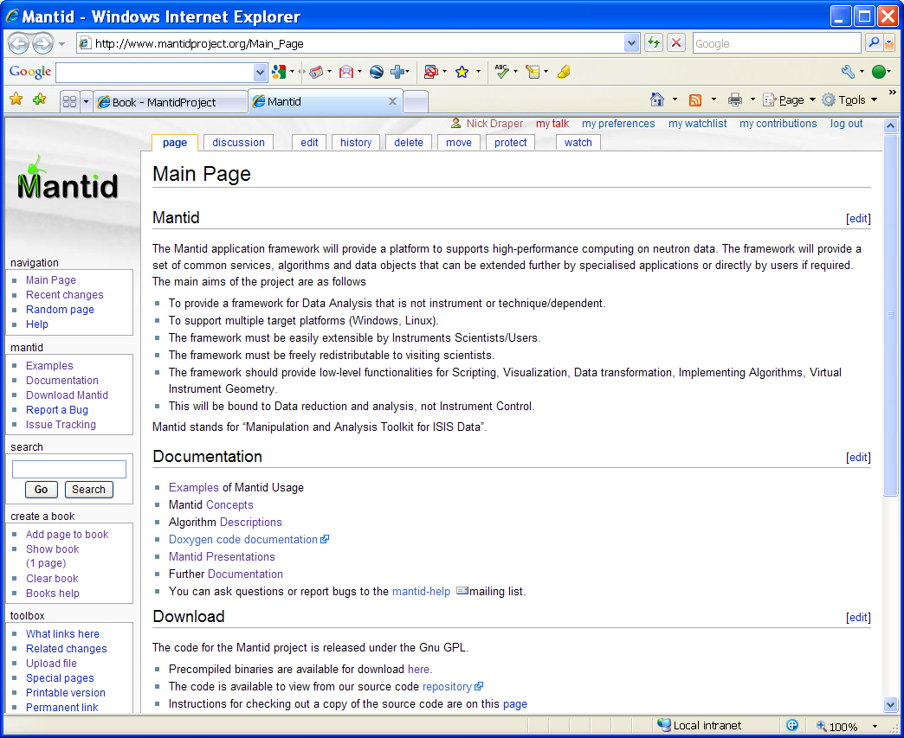
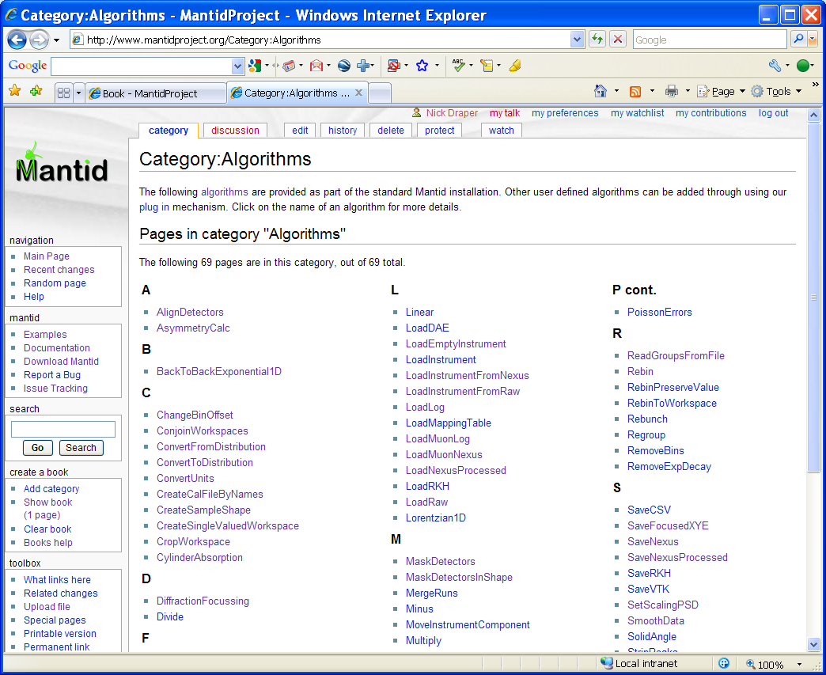
Project wiki
Help
  Documentation
    User
    Developer
  Examples
Download
www.mantidproject.org

Slide 6

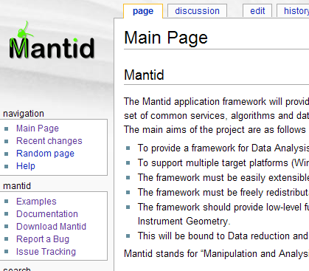
How to report a bug
Email mantid-help@mantidproject.org
Website
www.mantidproject.org
Phone (if urgent) 5228

Slide 7
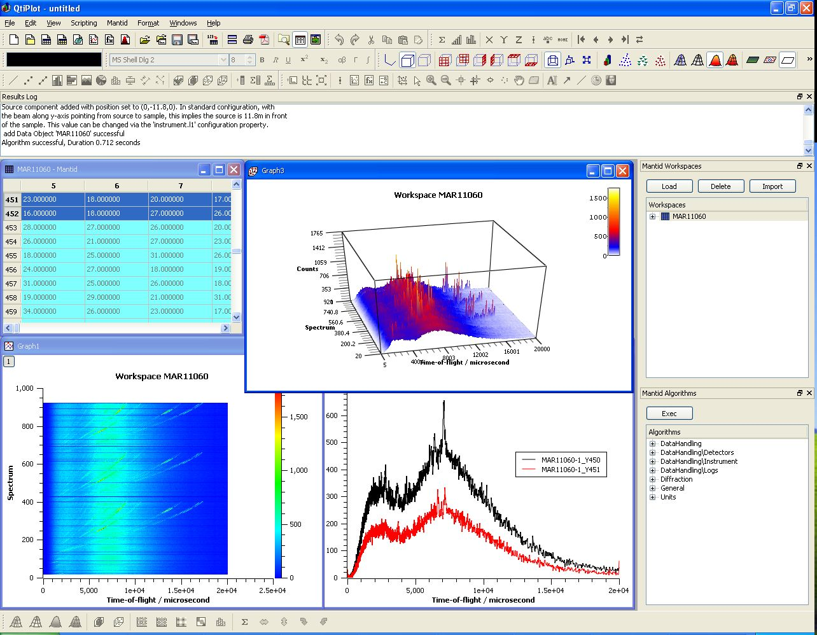
User Interfaces
Current Interfaces
  MantidPlot
    Plotting tool
    Data interaction and analysis.
    Instrument visualization
  Python
    Command line access and scripting
    Python scripting language

Slide 8
Further Information
Project Web Page
  www.mantidproject.org
Project Introduction Document
  http://svn.mantidproject.org/mantid/trunk/Documents/Requirements/Project%20Introduction%20Document.doc
User Requirements Document
  http://svn.mantidproject.org/mantid/trunk/Documents/Requirements/URD.doc
Architectural Design Document
  http://svn.mantidproject.org/mantid/trunk/Documents/Design/Architecture%20Design%20Document.doc

Slide 9
Preparation
Install Mantid
Grab a handout
Copy data files
  From USB:\Python Training\data
  Or \\??
  To c:\MantidInstall\Data

